Slide 1

Deep Q-Learning for Stock Trading Portfolio
Michael Owino
Michael Owino

Slide 2
Introduction
Objective: Develop an intelligent trading system using Deep Q-Learning to maximize portfolio returns
Application: Autonomous decision-making for stock trading (buy, sell, hold)
Data Source: 5-year historical stock data
Approach: Combining reinforcement learning with deep neural networks to learn optimal trading strategies

Slide 3
Industry Relevance
Quantitative Finance Revolution
Major hedge funds (Two Sigma, Renaissance Technologies, AQR) use RL + Deep Learning for:
Portfolio optimization
High-frequency trading
Market-making strategies
Our project aligns with cutting-edge industry practices.
Why DQN for Trading?
Adaptability: Learns from non-stationary market data (unlike static ML models).
Decision Automation: Mimics human intuition (buy/sell/hold) but scales computationally.
Risk-Aware: Penalties for illegal actions (e.g., -1000 reward) enforce real-world constraints.
Competitive edge
Traditional algos (e.g., mean-reversion) fail in trending markets; DQN adapts dynamically.
Your sparse reward design (-1000 penalties) mirrors institutional risk-management systems.

Slide 4

Q – Learning Foundation
Where:
- Q(s, a) is the Q-value for state s and action a.
- alpha is the learning rate, controlling how much new information overrides old information.
- R is the immediate reward for taking action a in state s.
- gammais the discount factor, representing the importance of future rewards.
- max_a Q(s’, a’) is the maximum Q-value for the next state s’, representing the best possible reward achievable from that state.

Slide 5
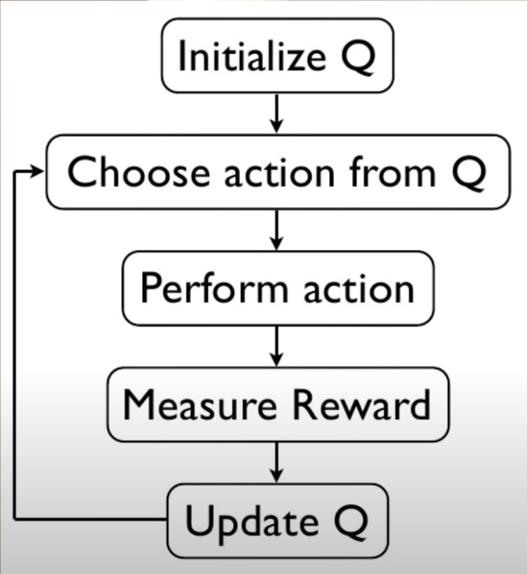
Q – Learning Foundation AGENT

Slide 6
Analogy & Context
Super Mario:
States (s): Mario's position, enemies nearby (analogous to market conditions)
Actions (a): Jump, run, move (analogous to buy, sell, hold)
Rewards (r): Coins collected, level completion (analogous to profit)
In our trading context:
States: Market trend direction, trading availability
Actions: Buy, sell, or hold positions
Rewards: Price changes and trading profits

Slide 7
Data Pipeline & Preprocessing
Dataset:
5 years of OHLCV data for AAPL (from all_stocks_5yr.csv)
Kaggle URL: https://www.kaggle.com/datasets/ameythakur20/stock-prices
Key features: close price (target), 5-day/1-day moving averages
Preprocessing:
Cleaning:
Dropped high/low/volume/Name columns
Removed NA values
Feature Engineering:
Added rolling MAs (5day_MA, 1day_MA)
Zero-padded initial MA values

Slide 8
Data Pipeline & Preprocessing
State Representation:
Tuple (market_trend, can_trade)
Trend: 0/1 based on MA crossover
Trade flag: Binary (cash vs. stock position)
Train-Test Split:
80-20 split (chronological)
Training: First 4 years
Testing: Most recent 1 year

Slide 9

Deep Learning Integration
Challenge: Traditional Q-tables cannot handle continuous state spaces in financial markets
Solution: Deep Neural Network as function approximator
Loss Function: MSE between predicted Q-values and target Q-values

Slide 10

Model Architecture
Input Layer: 2 neurons (market state representation)
Hidden Layer: 64 neurons with ReLU activation
Output Layer: 3 neurons (Q-values for Buy, Sell, Hold)
Optimizer: Adam (learning rate = 0.001)

Slide 11
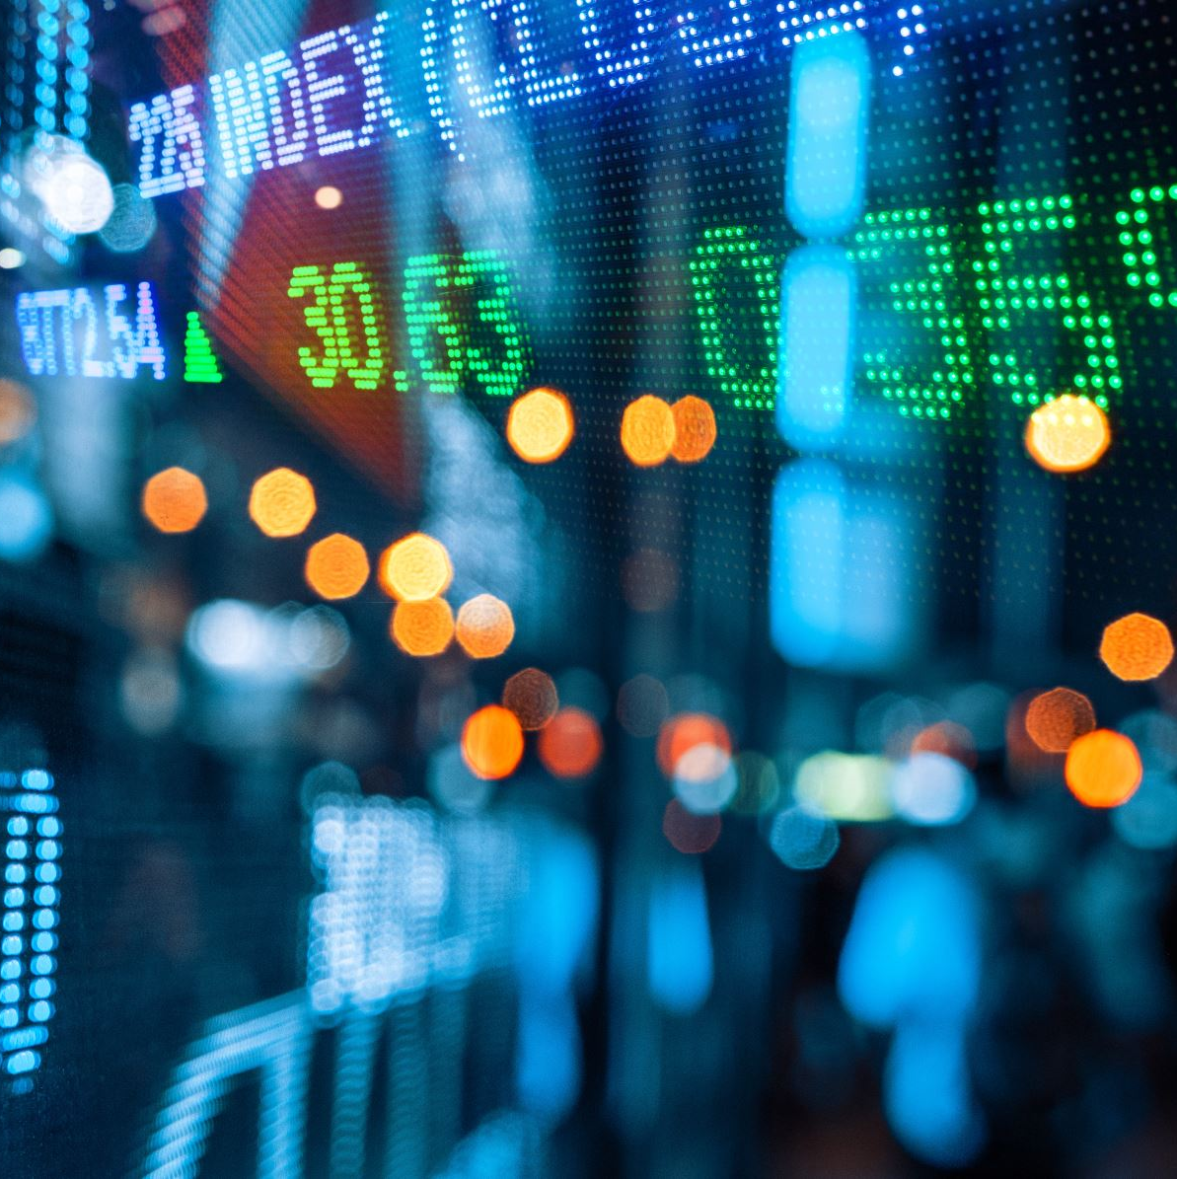
State Representation
Market Features:
5-day Moving Average (long_ma)
1-day Moving Average (short_ma)
Trading Availability: Binary flag indicating if portfolio can afford a purchase
State Encoding: (market_trend, can_trade) where market_trend is 0/1 based on MA crossover
Action Space
Buy (0): Purchase one share at current price
Sell (1): Sell one share at current price
Hold (2): Maintain current position

Slide 12
Reward Functions
Type: Sparse + Immediate Feedback Reward Function
Design Philosophy: Heavily penalize illegal actions while providing immediate price movement feedback
Buy Action:
-1000 if already in stock position (large penalty for illegal action)
0 if in cash position
Sell Action:
Current price - purchase price if in stock position (realized profit/loss)
-1000 if in cash position (large penalty for illegal action)
Hold Action:
Current price - previous price (reflects price movement)
Rationale: Large negative values (-1000) prevent illegal actions; price differences encourage profit-maximizing behavior

Slide 13
Training Process
Exploration Strategy: Epsilon-greedy (ε = 1.0 → 0.01)
Initial high exploration (100%) gradually decreasing to 1%
Encourages early discovery of state-action space
Experience Replay: Buffer size of 32 samples
Prevents correlated updates and stabilizes learning
Episodes: 100 training episodes chosen to balance exploration and exploitation
Target Network: Updated every 10 episodes to stabilize training
Initial Portfolio: $1,000

Slide 14
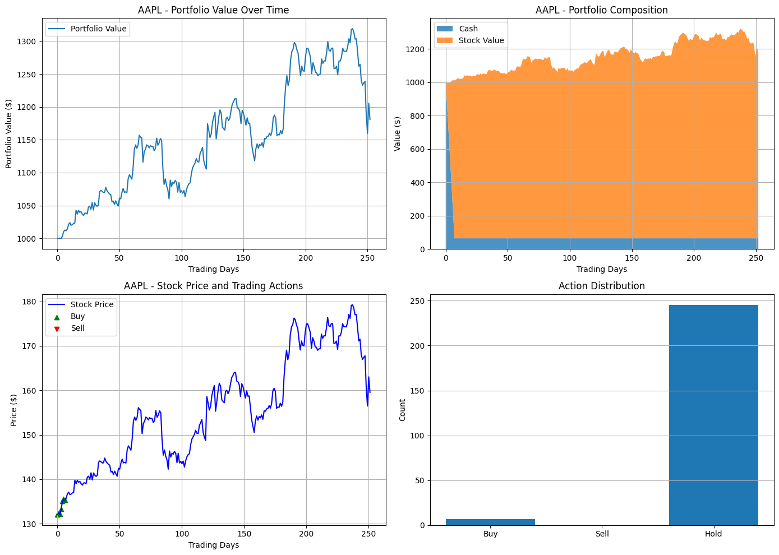
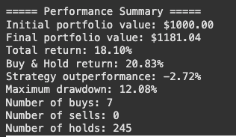
Testing Results - Apple

Slide 15
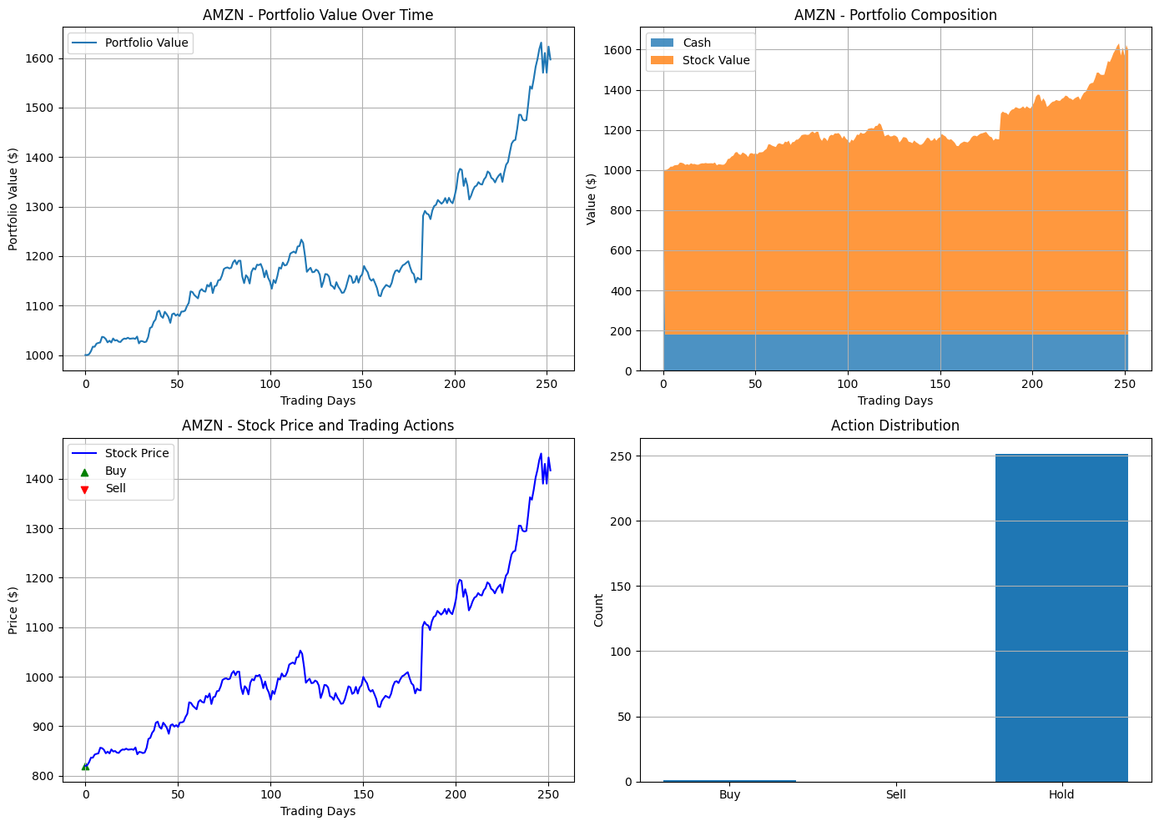
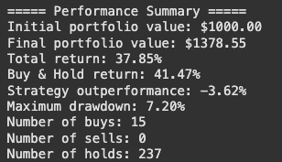
Testing Results - Amazon

Slide 16
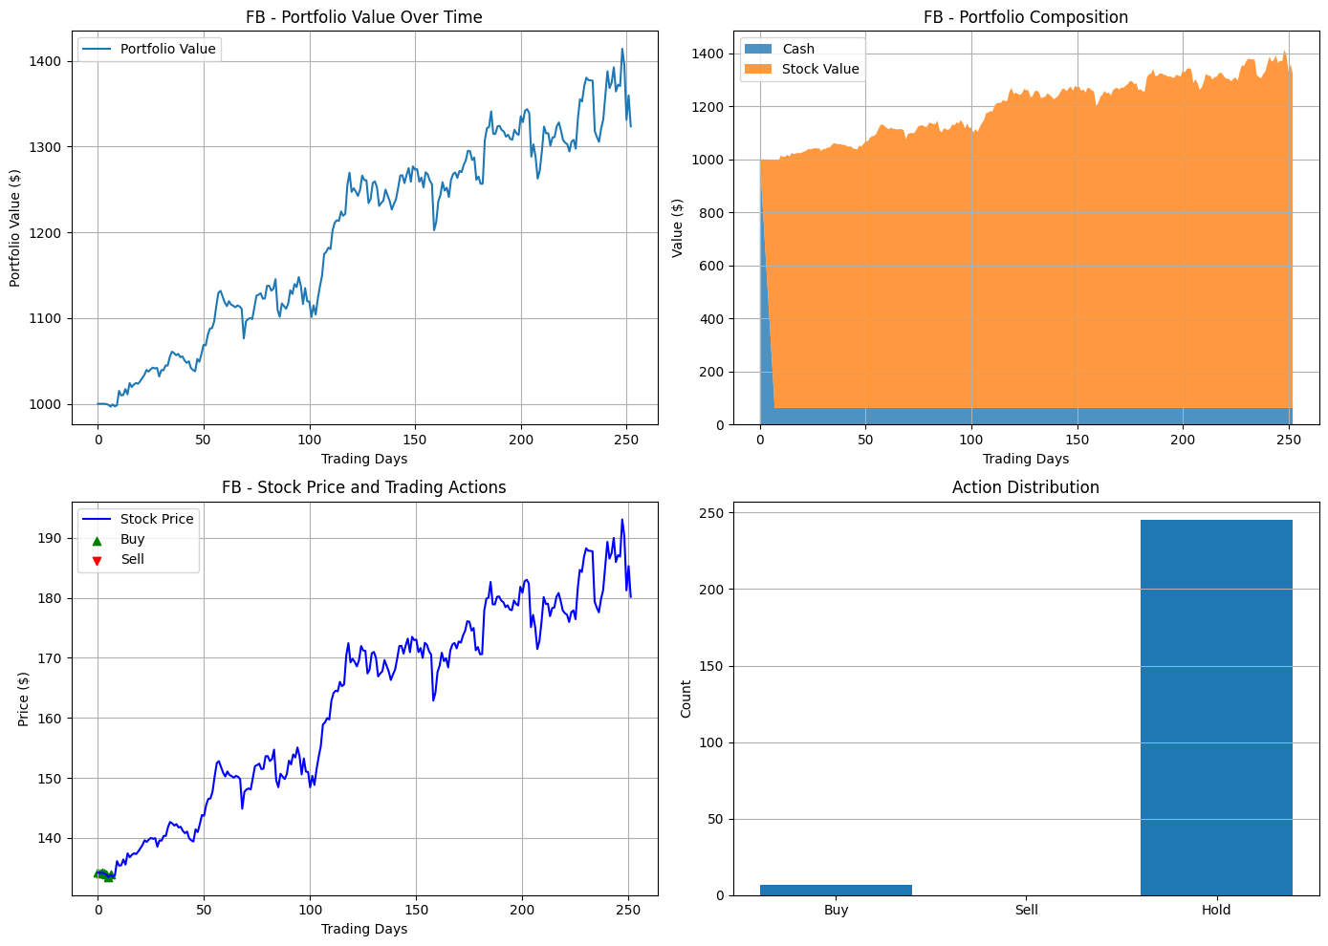
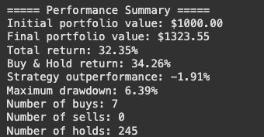
Testing Results - Meta

Slide 17
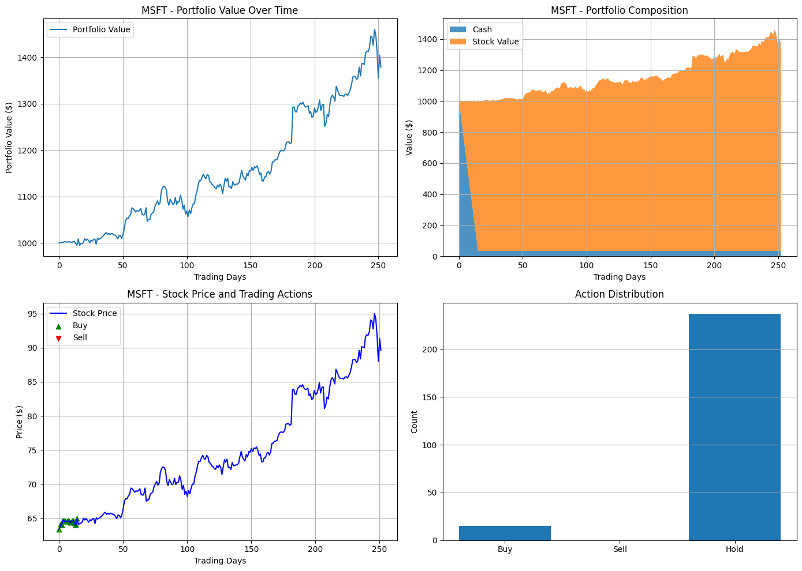
Testing Results – Microsoft

Slide 18
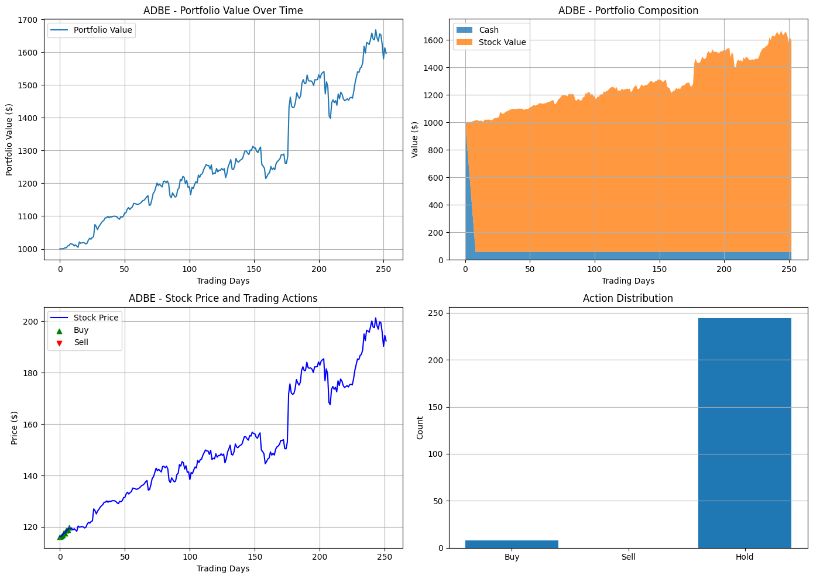
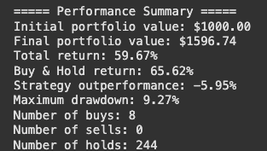
Testing Results - Adobe

Slide 19
Testing Results - Adobe
S&P 500 Context:
S&P returned 21.8% in 2017 → DQN beat it for MSFT/AMZN/GOOG but with higher risk.

Slide 20
Testing Results - Summary
Key Insights:
1. Consistent Underperformance:
DQN trailed Buy & Hold by 5.5% on average (worse for high-momentum stocks like AMZN).
2. Low Activity:
Rare trades (avg. 7 buys/stock, 0 sells) → Strategy overly favored "Hold."
3. Risk Mitigation:
Lower drawdowns vs. B&H in 3/5 stocks (e.g., MSFT: 7.2% vs 10.1%).

Slide 21
Conclusions & Future Work
Performance Analysis: Met S&P Benchmark for yearly projection
Improvement Areas:
Enhanced state representation (additional technical indicators)
More sophisticated reward function
Hyperparameter optimization
Longer training period
LSTM Integration: Incorporate Long Short-Term Memory networks to:
Capture temporal dependencies in price sequences
Recognize complex market patterns beyond MA crossovers
Integrate memory of past market behaviors into decision making

Slide 22
Conclusions & Future Work
Transaction Cost Modeling:
Implement realistic bid-ask spreads
Account for broker commissions and fees
Model market impact for larger position sizes
Optimize trade timing to minimize execution costs

